Slide 1
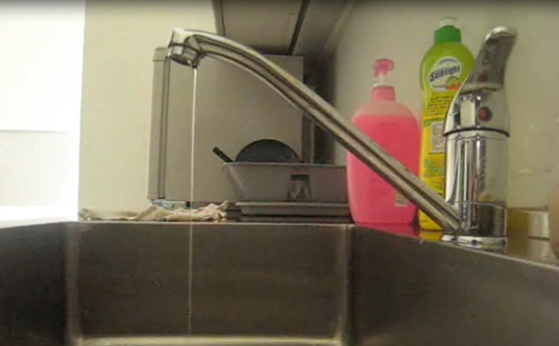
In this video, a charged object is placed near a stream of water.

Slide 2

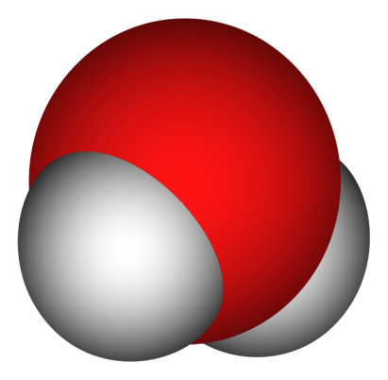
As you can see, water, or H₂O, has some interesting properties. Some other familiar properties of water are also unusual:
Ice (a solid) floats on water (a liquid) and
Water has a high boiling point compared to other similar molecules, like H₂S and Cl₂O (both of which are gases at room temperature).
Most of this can actually be explained by looking at the bonds in the water molecule.
O
H
H

Slide 3
Your challenge for the day!
Explain why the stream of water bends near a charged object by examining the bonds in a water molecule.
Hence, explain the unusual properties of water.

